Slide 1
NAT met PAT
The Dynamic Duo of Network Transformation

Slide 2
Why Do We Need NAT?
Resource Optimization: Allows multiple devices to share a single public IP address.
Security: Masks internal IP addresses from the external network.
IP Conflict Resolution: Resolves IP address conflicts in overlapping networks.

Slide 3
Types of NAT
Static NAT: One-to-one mapping between internal and external IP addresses.
Dynamic NAT: Multiple internal IP addresses are mapped to a pool of external IP addresses.
Port Address Translation (PAT): Multiple internal IP addresses are mapped to a single external IP address, differentiated by port numbers.
.. there is actually even more intricate classifications but we’ll stop at these three.

Slide 4
NAT Components
Inside Local: The original source IP address.
Inside Global: The translated source IP address.
Outside Local: The destination IP address as it appears to the internal network.
Outside Global: The destination IP address as it appears to the external network.

Slide 5
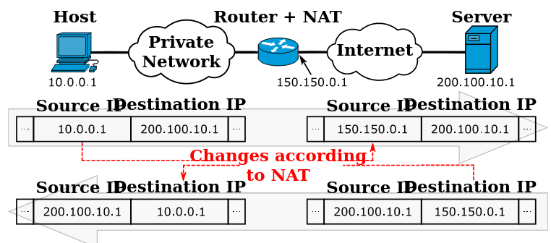
NAT Components

Slide 6
NAT Tables
Translation Table: Keeps track of all the mappings.
Timeouts: Entries in the NAT table have a timeout value to ensure old mappings are removed.

Slide 7
NAT and iptables
PREROUTING Chain: Handles incoming packets and performs Destination NAT.
POSTROUTING Chain: Handles outgoing packets and performs Source NAT.

Slide 8
Understanding Chains in NAT
Chains: In iptables, a chain is essentially a list of rules that are applied to packets as they traverse through it.
NAT Table: This is one of the specialized tables in iptables designed specifically for NAT operations.

Slide 9
The PREROUTING Chain
Definition: The PREROUTING chain is responsible for handling packets as they arrive at the network interface, before the routing decision is made.
When It Acts: As soon as the packet hits the network interface.
Main Job: Destination NAT (DNAT).
Example: Redirecting all incoming HTTP traffic to a specific internal server.
iptables -t nat -A PREROUTING -i eth1 -p tcp --dport 80 -j DNAT --to-destination 172.16.1.8:80
Before and After Rule Application:
Before: Incoming HTTP traffic is directed to the original destination.
After: All incoming HTTP traffic is now redirected to 172.16.1.8.
View Hits: To see if the rule is working, you can view the hits.
iptables -t nat -L PREROUTING -v -n | grep 80

Slide 10
The POSTROUTING Chain
Definition: The POSTROUTING chain is responsible for handling packets just before they leave the network interface.
When It Acts: Right after the routing decision is made, just before the packet is sent out.
Main Job: Source NAT (SNAT).
Example: Changing the source IP of all outgoing traffic from the LAN to the public IP.
iptables -t nat -A POSTROUTING -o eth1 -s 10.81.100.0/24 -j SNAT --to-source 200.1.1.1

Slide 11
The POSTROUTING Chain
Before and After Rule Application:
Before: Outgoing packets retain their original source IP.
After: All outgoing packets from the LAN now have their source IP changed to 200.1.1.1.
View Hits: To see if the rule is working, you can view the hits.
iptables -t nat -L POSTROUTING -v -n | grep 200.1.1.1

Slide 12
Introduction to PAT (Port Address Translation)
PAT is a subtype of NAT that allows multiple devices on a local network to be mapped to a single public IP address by using different port numbers.

Slide 13
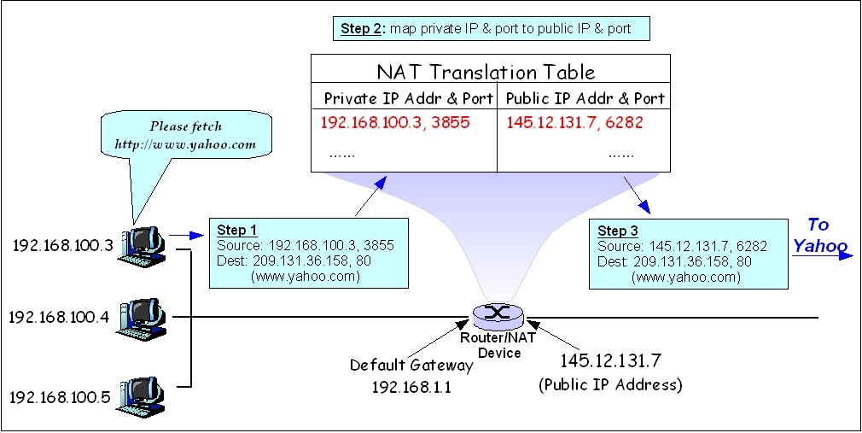
Introduction to PAT (Port Address Translation)

Slide 14
Why is PAT Important?
Resource Optimization: Allows multiple hosts to share a single public IP.
Security: Obscures internal IP addresses.
Cost-Effective: Reduces the need for multiple public IPs.

Slide 15
How Does PAT Work?
Mechanism: PAT modifies not just the source IP address but also the source port in the IP headers of packets.
Example: Multiple users accessing a website will have their requests sent through different source ports but the same public IP.

Slide 16
Understanding MASQUERADE in iptables
What is MASQUERADE?
Definition: The MASQUERADE target is used in iptables to perform Source NAT for a dynamic IP address.
Why Use MASQUERADE?
Dynamic IPs: Ideal for situations where the public IP address is dynamically assigned, such as with DHCP.
Ease of Use: Automatically handles the changing of the public IP address, no need to specify it.

Slide 17
How Does MASQUERADE Work?
Mechanism: It takes the IP address of the outgoing network interface and uses that as the source address for all the packets traveling through it.
Example: If your router's WAN interface (eth1) has a dynamic IP, MASQUERADE will use whatever IP is assigned to eth1 as the source IP for packets leaving the network.

Slide 18
MASQUERADE vs SNAT
SNAT: Requires a specific IP to be set and doesn't change automatically.
MASQUERADE: Automatically adapts to IP changes, more CPU intensive.

Slide 19
MASQUERADE vs SNAT
SNAT: Requires a specific IP to be set and doesn't change automatically.
MASQUERADE: Automatically adapts to IP changes, more CPU intensive.

Slide 20
MASQUERADE vs SNAT
Example Command Explained:
iptables -t nat -A POSTROUTING -o eth1 -s 10.81.100.0/24 -j MASQUERADE
-t nat: Specifies the NAT table.
-A POSTROUTING: Appends a rule to the POSTROUTING chain.
-o eth1: Specifies the outgoing interface.
-s 10.81.100.0/24: Specifies the source IP range.
-j MASQUERADE: Sets the target to MASQUERADE, performing Source NAT.

Slide 21
Viewing MASQUERADE Hits
iptables -t nat -L POSTROUTING -v -n | grep MASQUERADE

Slide 22
Stateful vs Stateless NAT
Stateful NAT: Keeps track of the state of each connection and allows bidirectional initation.
Stateless NAT: Does not keep track of connection states; generally used in simpler, less secure setups.

Slide 23
What is Stateful NAT?
Definition: Stateful NAT keeps track of the state of each active connection. This means it remembers the source and destination IP addresses and port numbers, as well as the state of the connection (e.g., SYN_SENT, ESTABLISHED).
Advantages:
Bidirectional Initiation: Allows connections to be initiated from both sides, not just from inside to outside.
Higher Security: By tracking state, it can prevent unsolicited incoming traffic that doesn't correspond to a known active connection.
Dynamic Port Mapping: Can dynamically allocate ports for outgoing connections and free them when the connection is closed.

Slide 24
What is Stateful NAT?
How it Works:
Uses a state table to keep track of each connection.
Examines each packet to update its state table.
Makes decisions based on the state table for allowing or denying packets.

Slide 25
What is Stateless NAT?
Definition: Stateless NAT performs address translation without keeping track of each individual connection's state.
Advantages:
Simplicity: Easier to set up and manage.
Less CPU Intensive: Doesn't require as much processing power since it doesn't keep a state table.

Slide 26
What is Stateless NAT?
Disadvantages:
Lower Security: More susceptible to attacks like IP spoofing.
Unidirectional: Generally allows connections to be initiated only from one side, usually from inside to outside.

Slide 27
Stateful NAT in iptables
Connection Tracking: iptables uses the conntrack module for stateful NAT.
Example: To allow established and related incoming connections. bash
iptables -A INPUT -m conntrack --ctstate ESTABLISHED,RELATED -j ACCEPT

Slide 28
Stateless NAT in iptables
Simple Rule: A basic NAT rule without state tracking.
Example: To simply forward all incoming HTTP traffic to a specific internal IP.
iptables -t nat -A PREROUTING -p tcp --dport 80 -j DNAT --to-destination 10.81.100.10

Slide 29
Challenges with NAT
Breaking End-to-End Connectivity
What is End-to-End Principle?: In a pure IP network, each packet would travel from the source directly to the destination without any changes to the packet headers.
How NAT Breaks It: NAT modifies the source or destination IP addresses, and sometimes the port numbers, as packets pass through. This breaks the end-to-end principle because the integrity of the packet is altered.
Implications:
Troubleshooting: Makes it difficult to trace network issues.
Quality of Service (QoS): Can interfere with QoS mechanisms that rely on the original IP headers.
Security: Some security protocols like IPsec may not work well with NAT.

Slide 30
Challenges with NAT
Complications in VoIP and Gaming
Why It's a Problem: Both VoIP and gaming often use dynamic port numbers and may require incoming connections to be initiated from the outside world. NAT can interfere with this.
NAT Traversal Techniques:
STUN (Session Traversal Utilities for NAT): Allows a client to discover its public IP address.
TURN (Traversal Using Relays around NAT): Uses a relay to pass traffic through.
UPnP (Universal Plug and Play): Allows devices to automatically configure port forwarding.

Slide 31
Challenges with NAT
Complications in VoIP and Gaming
Examples:
VoIP: SIP protocol often faces issues with NAT as it embeds IP addresses within the payload, which NAT doesn't usually alter.
Gaming: Multiplayer games often require a range of ports to be open, which can be problematic with NAT.

Slide 32
Challenges with NAT
Complications in VoIP and Gaming
Workarounds:
Port Forwarding: Manually configure your NAT device to forward certain ports.
DMZ (Demilitarized Zone): Place the affected device in a DMZ, effectively bypassing the NAT for that device (not recommended for security reasons)

Slide 33
Summary of Tables and Chains
NAT Table
Purpose: Primarily used for Network Address Translation (NAT).
Chains:
PREROUTING: Handles incoming packets and performs Destination NAT.
POSTROUTING: Handles outgoing packets and performs Source NAT.

Slide 34
Summary of Tables and Chains
Filter Table (Revisited)
Purpose: Used for basic packet filtering.
Chains:
INPUT: Deals with incoming packets destined for the system itself.
FORWARD: Handles packets being routed through the system.
OUTPUT: Manages outgoing packets originating from the system.

Slide 35
Key Takeaways
NAT Table: Essential for translating network addresses, both source and destination.
Filter Table: The workhorse for packet filtering, used in most basic setups.

